Slide 1

Transformer- Modern NLP Techniques

Slide 2
Transformers are powerful tool that allows to address a lot of sequence to sequence problems (any problem where you have an input sequence or a sequence of text and you want to get as outputs another sequence/text) .
So it is not about classification. It could be many things like translation, text summarization or even chat.
Another reason is that it’s really different from standard neural networks like fully connected neural networks, RNN or CNN. It works differently and its really interesting on how it provides new way of how to process language or even how to understand human language.
The history of this comes from the Standard RNN that were broadly used for sequence to sequence problems. (Just by adding new tools, removing all features from the model little by little Google came upon this model Transformer.
Transformer Advanced Sequence to Sequence

Slide 3
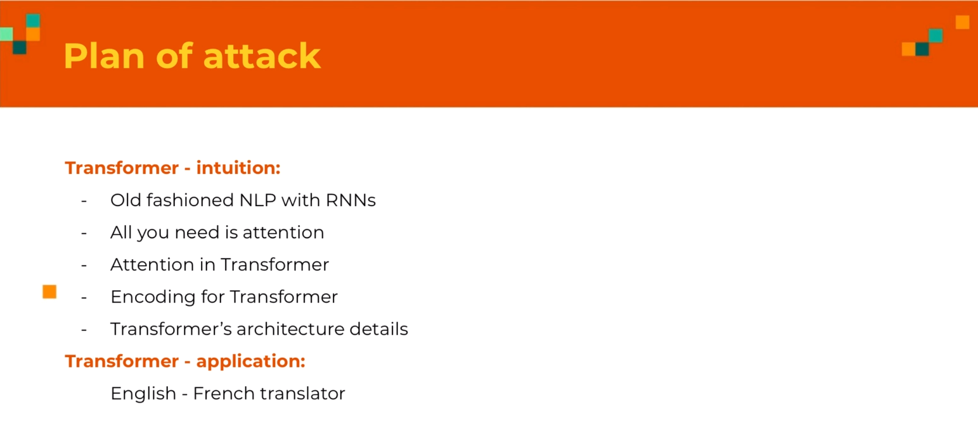
Transformer Intuition – Plan of attack

Slide 4
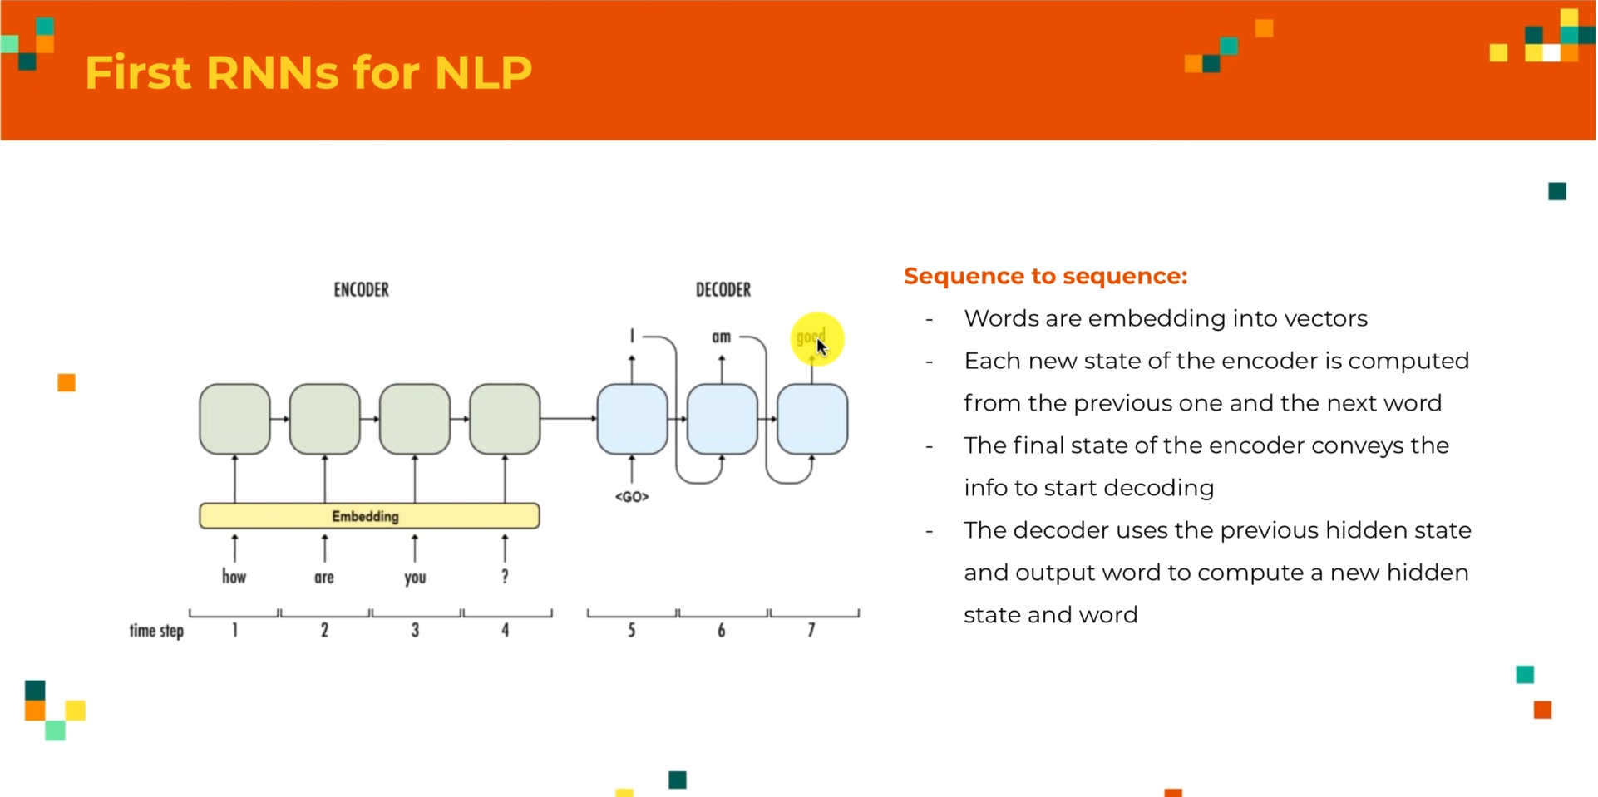
Transformer Intuition – Old fashioned NLP

Slide 5
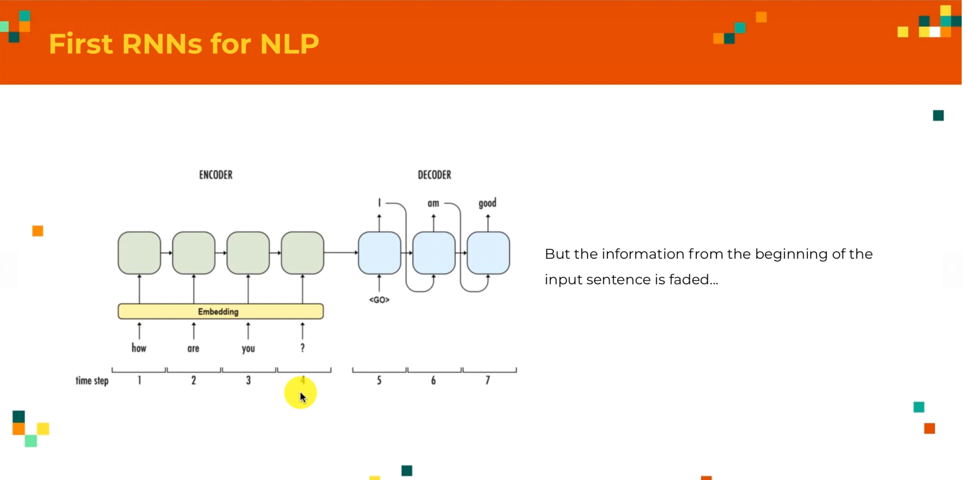
Transformer Intuition – First RNNs for NLP

Slide 6
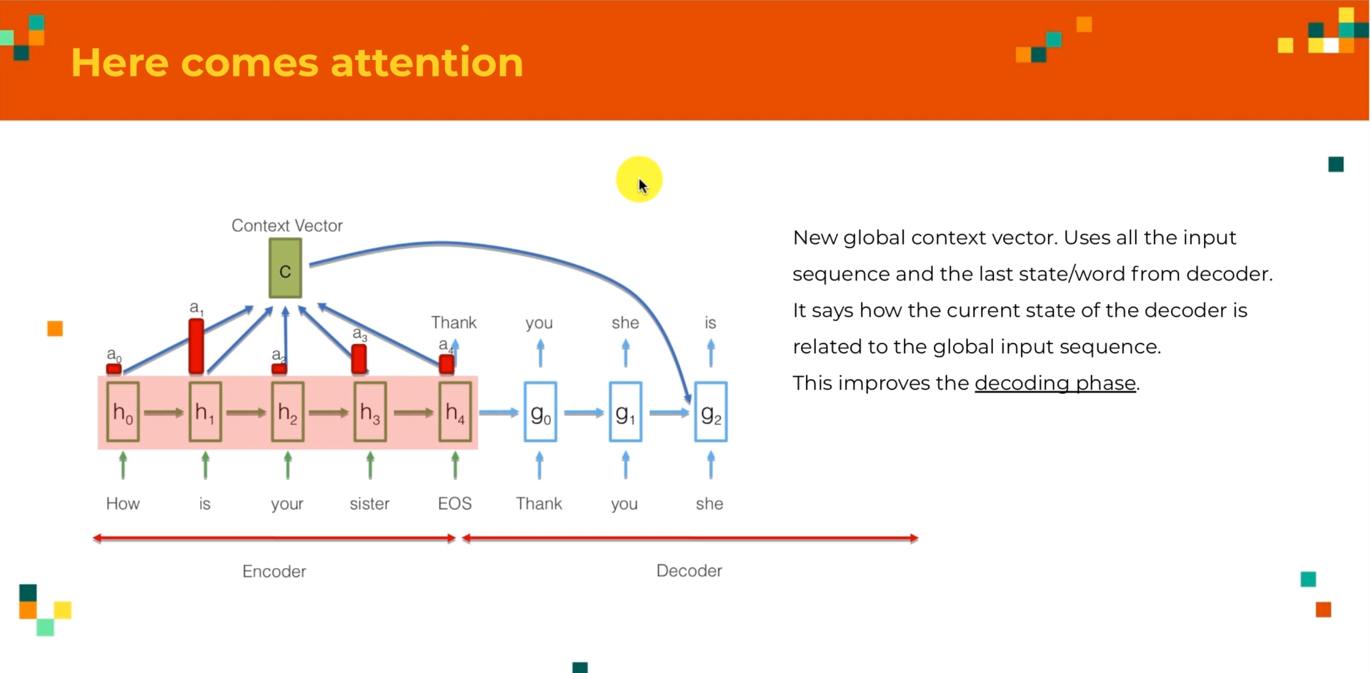
Transformer Intuition – First RNNs for NLP – Here comes attention

Slide 7
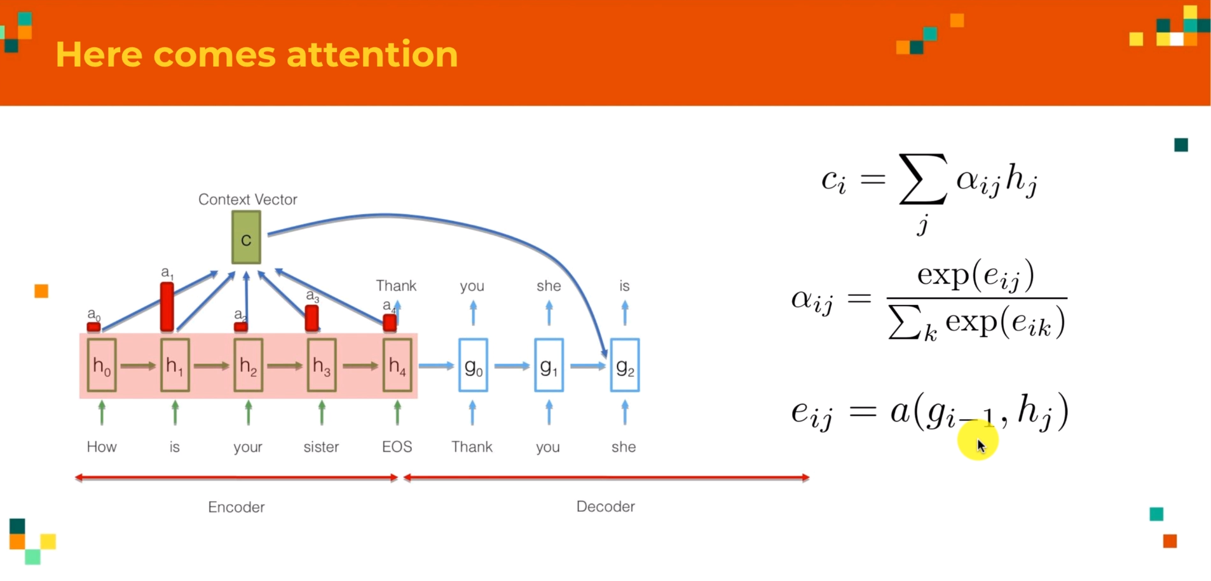
Transformer Intuition – First RNNs for NLP – Here comes attention

Slide 8
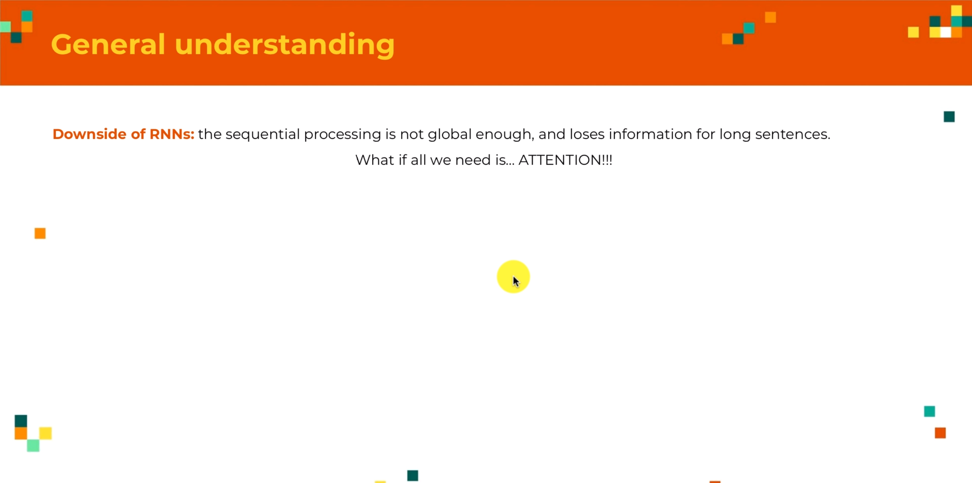
Transformer Intuition – General understanding

Slide 9
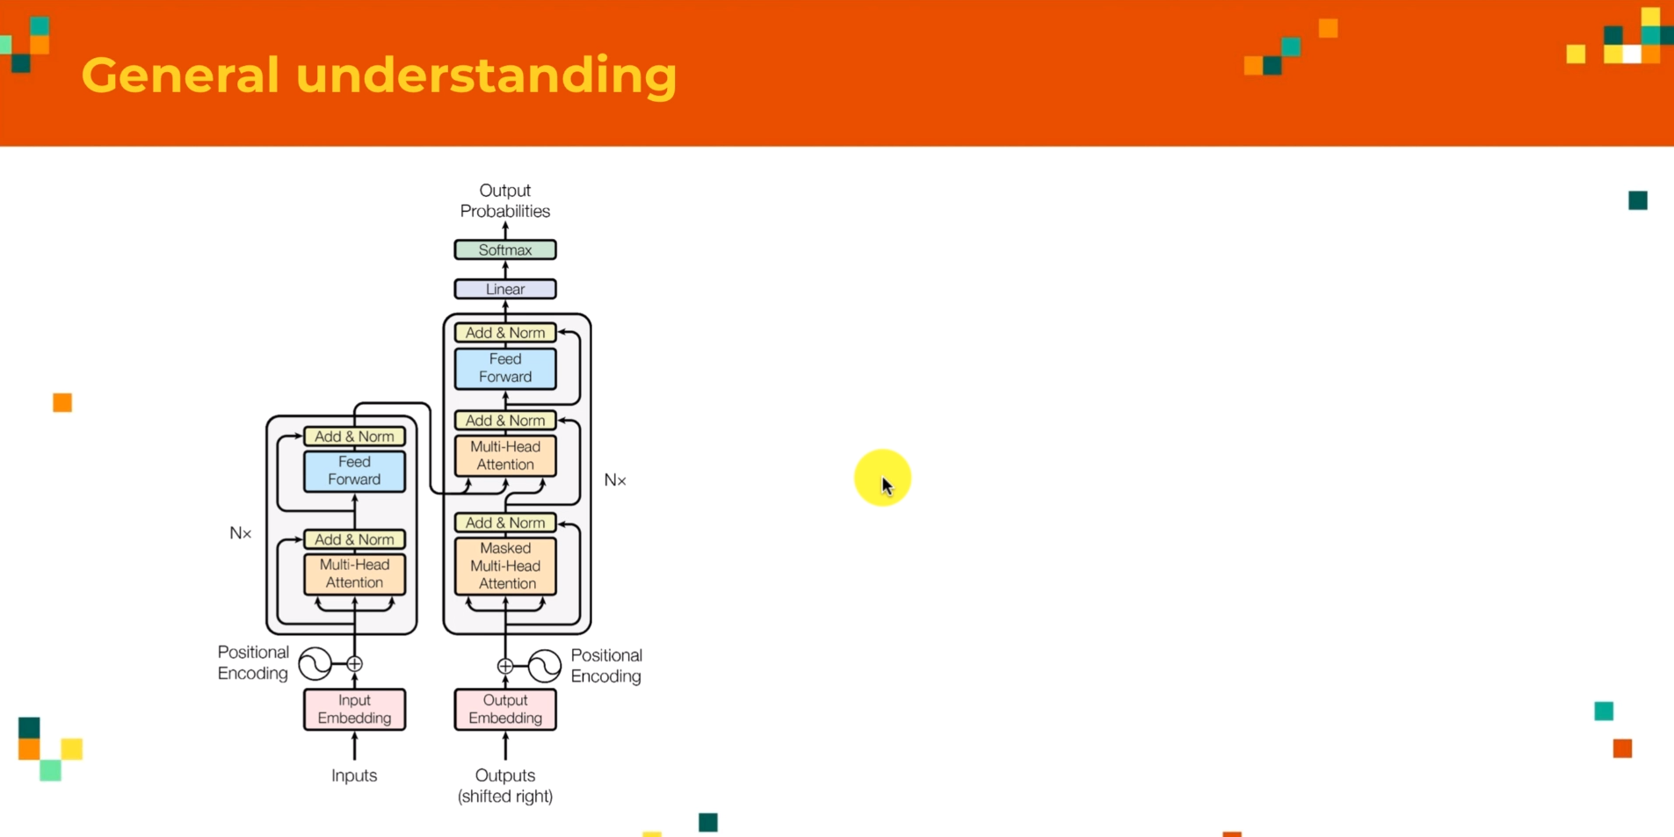
Transformer Intuition General understanding
Here there are 2 Main Blocks:
The First one (left) encoder
The Second one (right) decoder
Inputs from the Encoder and Outputs from the Encoder will be part of the Inputs of Decoder
(This is the same as the RNN Encoder/Decoder Architecture)

Slide 10
Transformer Intuition General understanding
The key difference is that out inputs for the encoder will be the whole sentence at once;
So we don’t feed the encoder one word at a time, we just give it whole sequence and it will process the whole sequence at once;
This is important to keep the global aspect of the processing that we wanted to have;

Slide 11
Transformer Intuition General understanding
Second thing that we wanted to notice is the Inputs for the Decoder; (In the diagram, it states output, it is because we use the outputs of our decoder as new inputs for the decoder as we did before);
But once again, we do it with the whole sentence;
Lets say for instance that all transformer has been made to build a chatbots and the input sequence will be how are you doing for instance;
So first time we apply our transformer, we will have as inputs for the encoder the whole sentence – “How are you doing” is given as the Input to the Encoder.
For the decoder, we will give the input just the token, <start token> and it does not convey any meaning it is just to tell the transformer that it is the beginning of the sentence;
Giving that the application of the Transformer, we will get the Output one element – “I”
We will then add “I” to the output of the decoder and this will become the start token “I”, then we repeat the same process, keeping the same process, we will add new words to output of the decoder to get something like: “I am fine, thank you”;

Slide 12
Transformer Intuition General understanding
Next thing to note is the Orange box, Which talks about the “Attention”
This is the Key aspect of the Transformer and it is based on the “Attention Mechanism” that we saw earlier as it applies to the “RNN”
The idea is that when you have 2 sequences, it is just recompose the first sentence, according to how each element of the first sentence is related to the elements of the second sentence.
We also see that in the first stage, why we have Input sentence, we use 3 times the same sentence; and that is what they call “Self-Attention” which is the key for the Encoder Step in the Transformer. (This is in contrast to the Standard RNN, where we used the time sequence to generate next sequence, but what we do here : We have the whole sentence and we will see how each words of each sentence is related to the other words of the same sentence)
Then we will recompose the same sentence according to that.

Slide 13
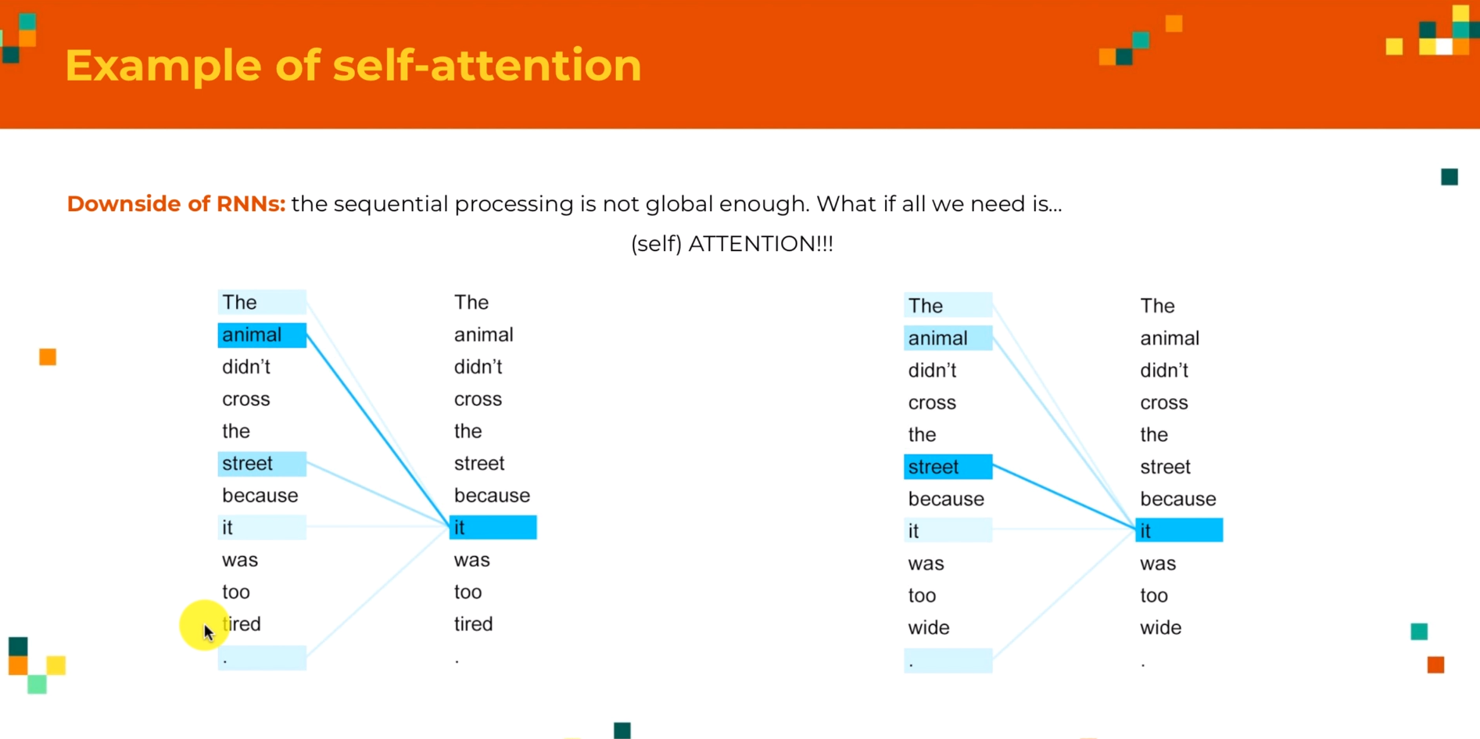
Example of self-attention
In the self-attention, it computes how each word of the sentence relates to the other words;
Here it understands that “it” refers/attends to the word “animal” (as it is the animal that was too tired)
But if we take another example like, “it” refers/attends to the word “street”, since it was the “street” that was too wide;
The “Self-Attention” Mechanism understands that;
So, if we feed, that sentence to the “Self-Attention” Layer, like we have in the Encoder, Each sentence is fed to attention, the self attention layer computes what it refers to;
This is what is used in the Encoder step of the Transformer; We do the same thing for the decoder as well;

Slide 14
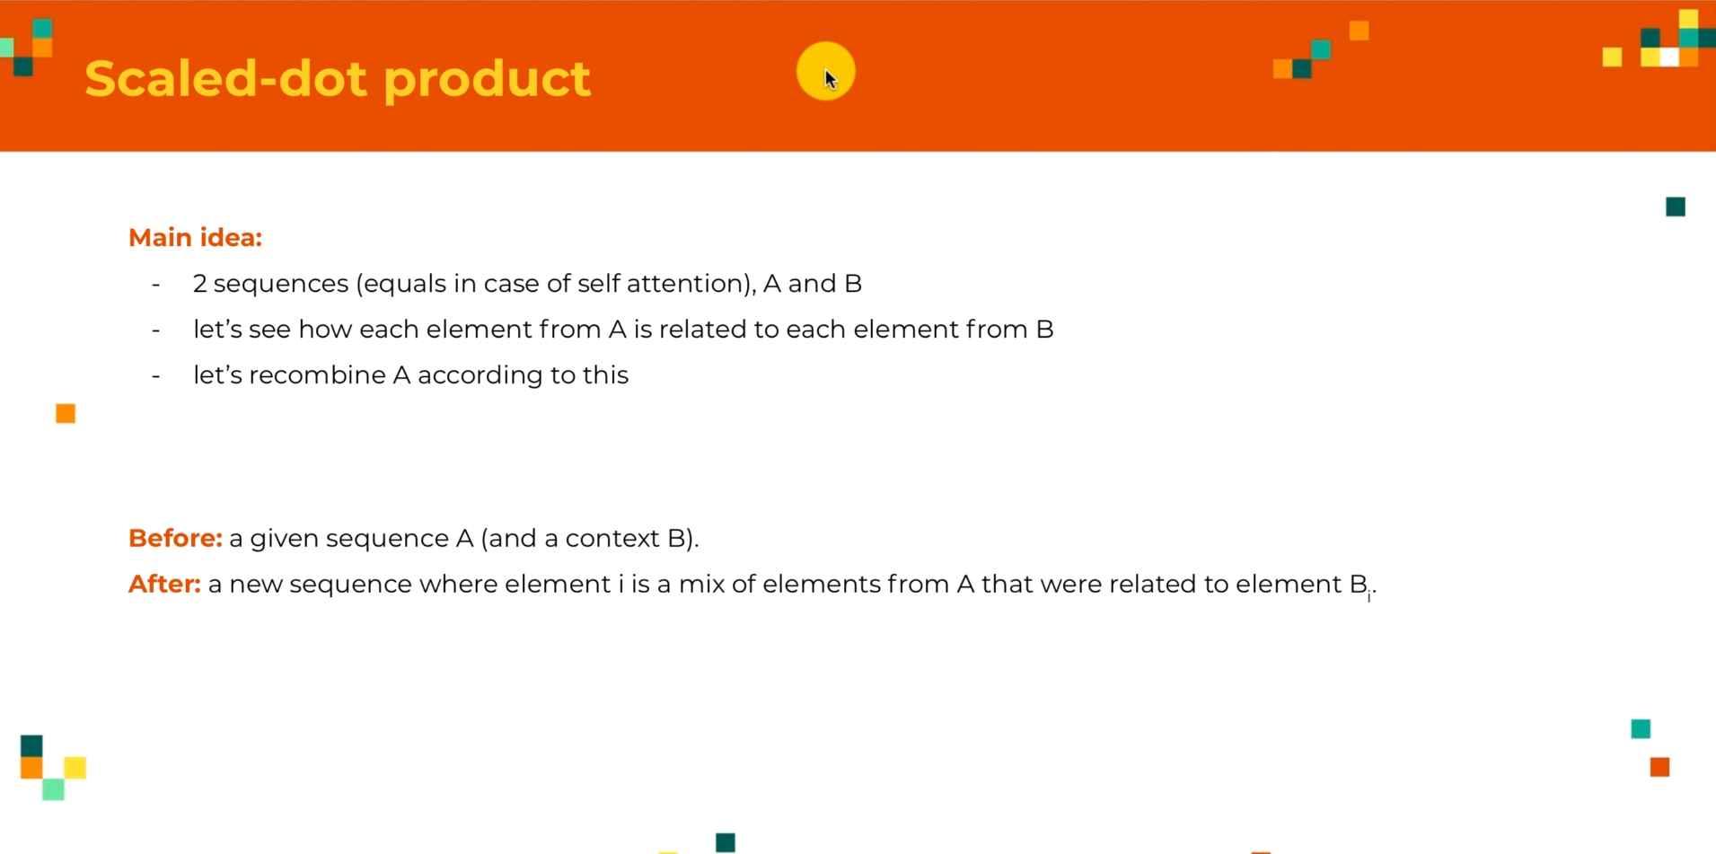
Attention in Transformer
The basic premise of how Transformer works, is we want to see how each element from “A” is related to elements from “B” and
Then we want to Recombine all the elements from “A” according to those relations (we want to re-arrange the information in “A” according to how each element of “A” is related to each elements from “B”)
Applying “Before” and “After” this Attention Mechanism, we have the beginning “Sequence A” and a “Context B” (that tells how we manipulate “A” and have an output with new sequence, where each element “i” will be a mix from “Element A” that were related to the “Element Bi”;
Generally speaking “B” tells us how we recombine elements from “A” (or in the case of Self-Attention “A” tells us how we recombine “A”)
So there are 2 steps to this one:
Compute the relations between element “A” and “B”
Use that in order to recombine ”A”
Next slide talks about (1) Getting the Relations between Element “A” and “B”

Slide 15
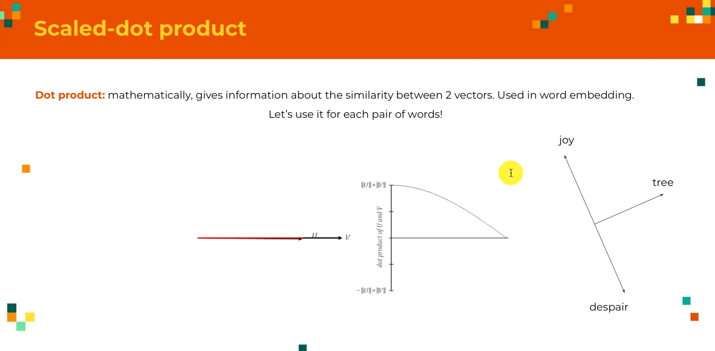
Self-Attention : Scaled-dot product
We know that each word/each element would be a vector (as we applied embedding to each words)
To compute similarities between 2 vectors is to use the dot product;
Two vector will be equal if their dot product = 1 and no correlation if their dot product = 0 & correlated in opposite manner if dot product = -1

Slide 16
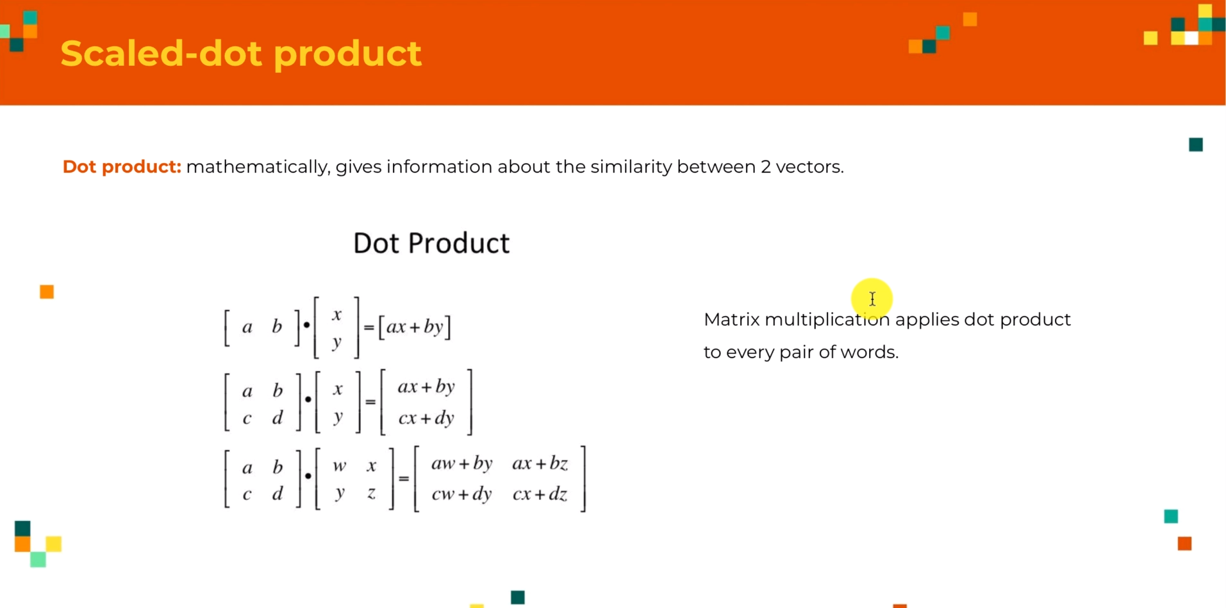
Self-Attention : Scaled-dot product

Slide 17
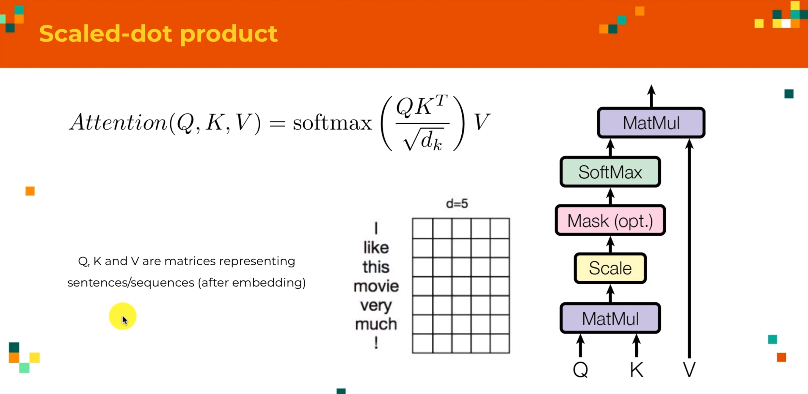
Self-Attention : Scaled-dot product
We understood that we want to apply “dot products” to each pair of words (or each pair of elements) from our sequences in order to compute the similarity
We know that we can do that with the “whole sequences at a time” just by using “matrix multiplication”
So we can go back to the paper and the formula is represented as below:
Here we have 2 sequences :
Sequence “A” and Sequence “B” and the “K” (Keys”) and “V” (Values) will always be the same in the Transformer and “Q” could be different;
“Q” is the context for sequence “B” and “Q” and “V” are the sequences that convey the information that we want to re-arrange”,
“K” and “V” are the sentence “A”;

Slide 18
Self-Attention : Scaled-dot product
First step that we see here is we multiple, “Q” (“Context Sentence” with the “Sequence K”) ,
After this Embedding, Each Sequence is a Matrix, we get all the “dot-products” that we wanted that we discussed earlier;
The “T” is the Transpose (We flip the matrix in order to transform, any horizontal vector into vertical vector and vice versa);
(This Enables the dot-product between all pairs of the elements from the 2 sequences – “Q” and “K” or “V” and “A”)
Thus the “numerator” operations gives a new matrix, that conveys all the information about how “Q” is related to “K”
Or more precisely how, each elements or each words of “Q” is related to each elements of “K”
The next step “denominator” is the “small scale”, it does not have any intuitive meaning, its just something to improve the model.
(This is just used for “standardization of dimensions”)
The next step is the application of “Softmax”, that takes as input a vector and outputs a vector of same dimension, but each element will be between 0 & 1; (We keep the relationships of each vector);
Now we have perfect representation of how each element from “Q” is related to each element from “K”;
(How each element from Sentence “A” is related to each element from Context Sentence “B”);
Finally we will use those weights to “recompose” all elements from “A” (aks “V”) which is used to rearrange information in “A”

Slide 19
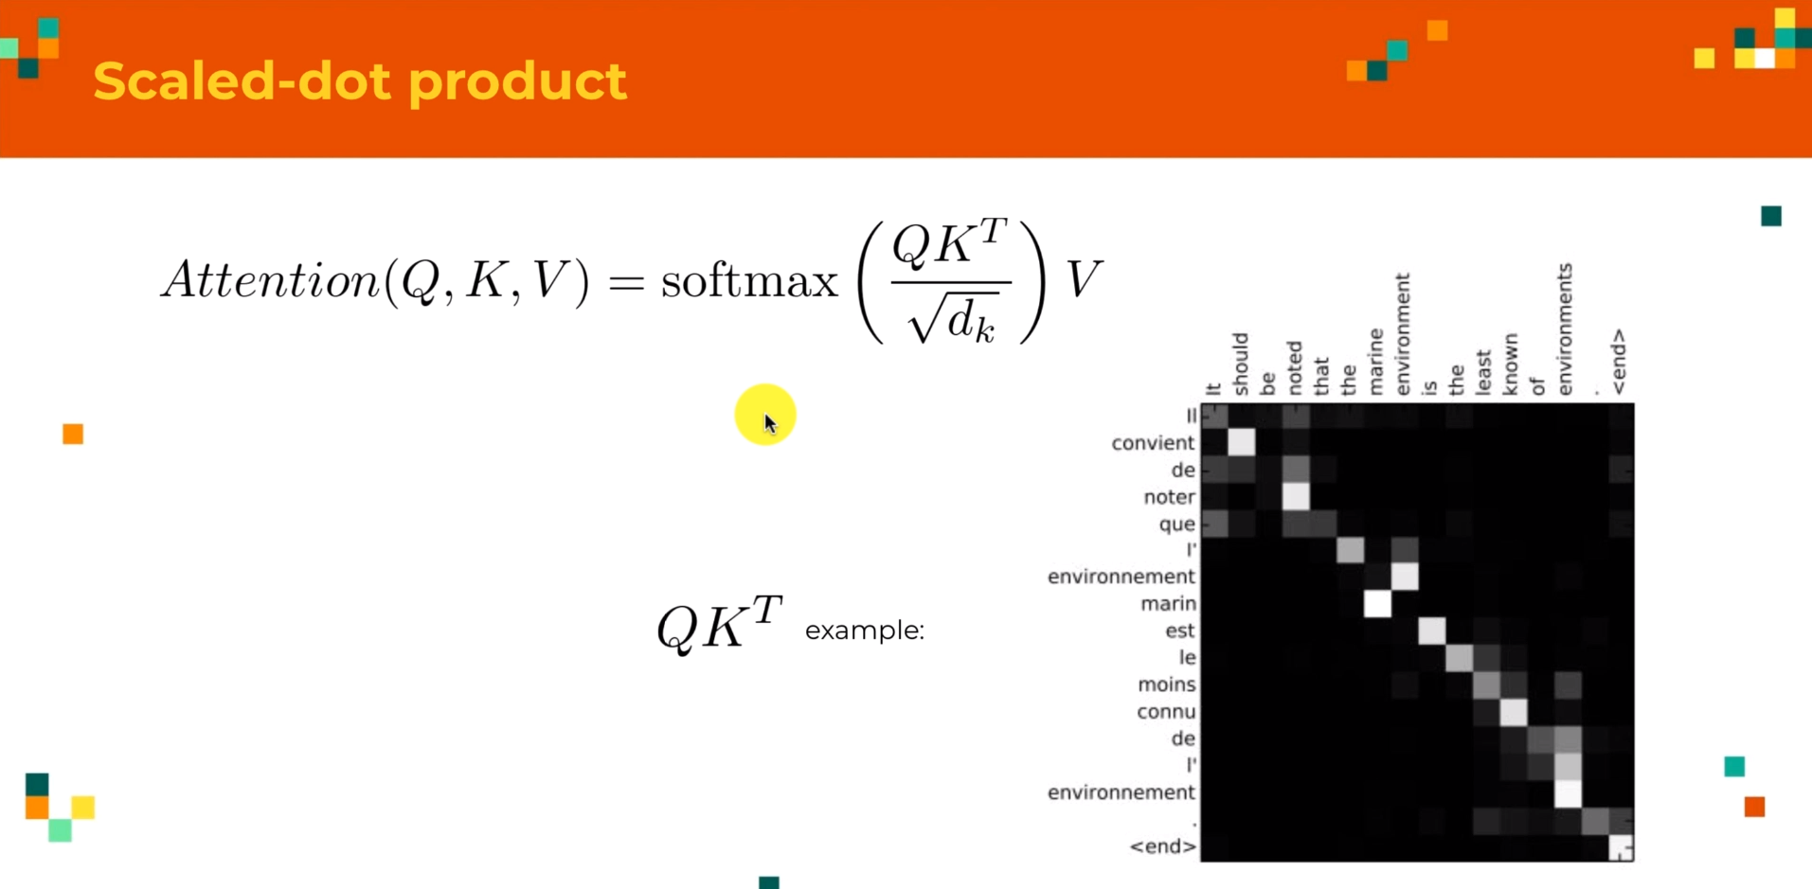
Self-Attention : Scaled-dot product

Slide 20
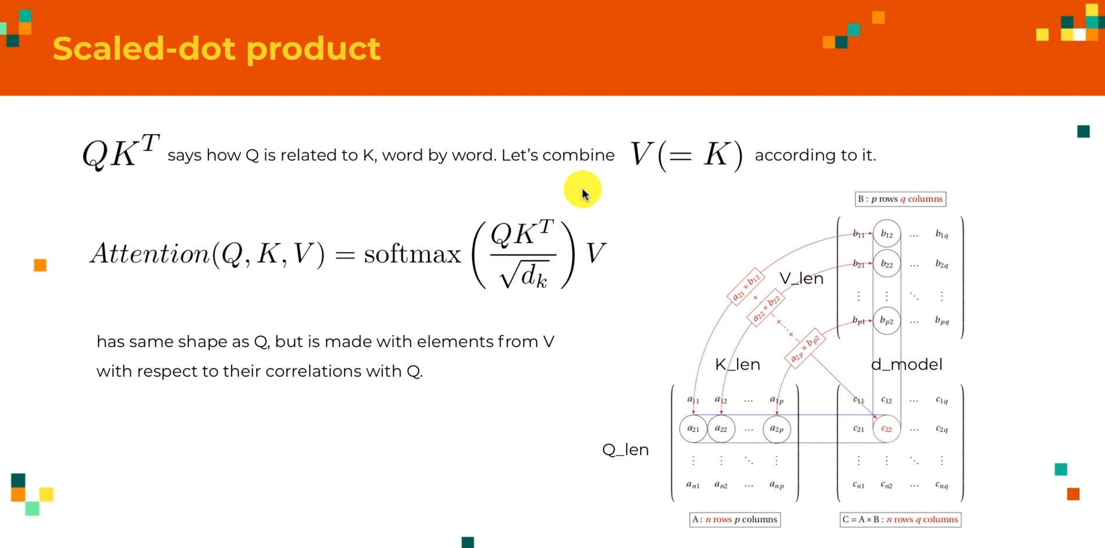
Self-Attention : Scaled-dot product

Slide 21
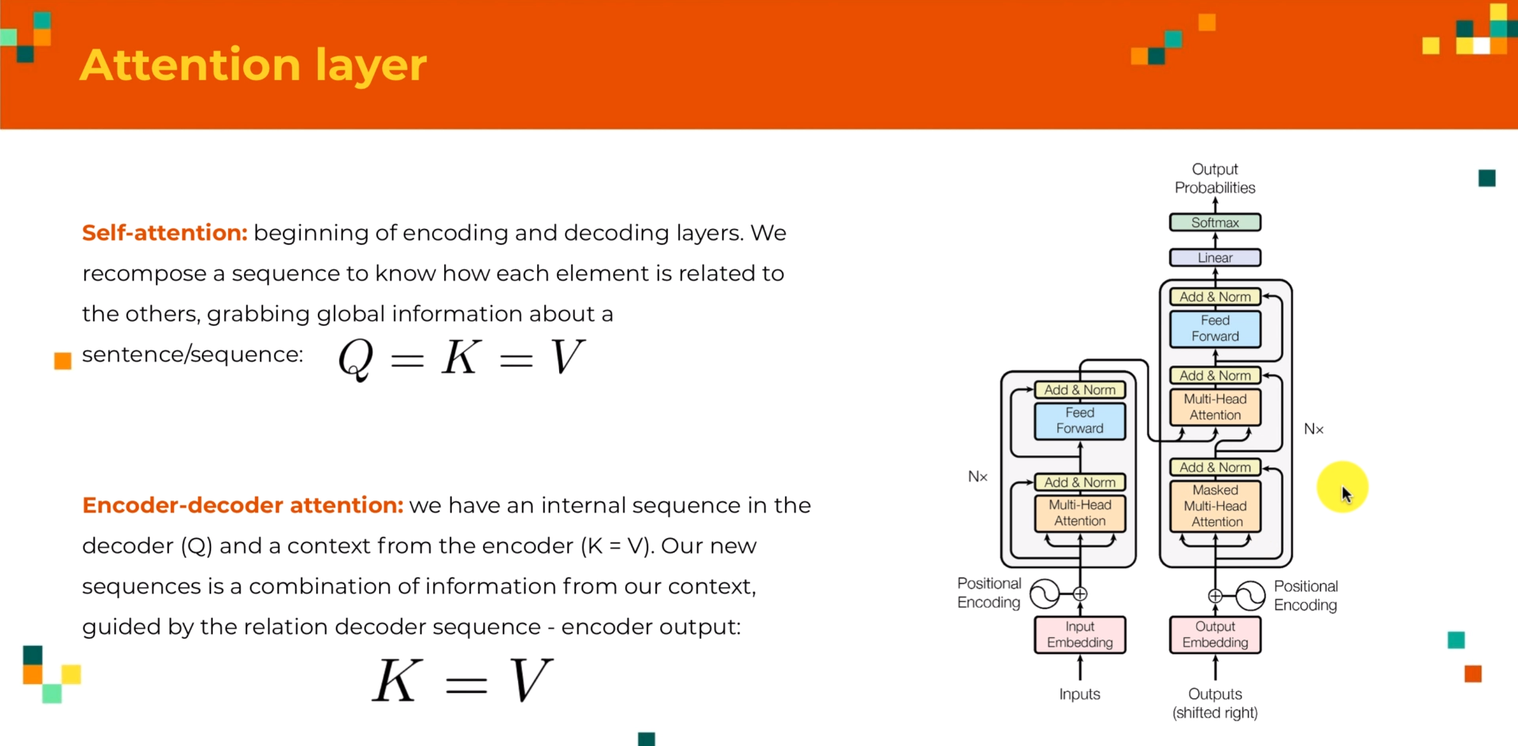
Attention Layer

Slide 22
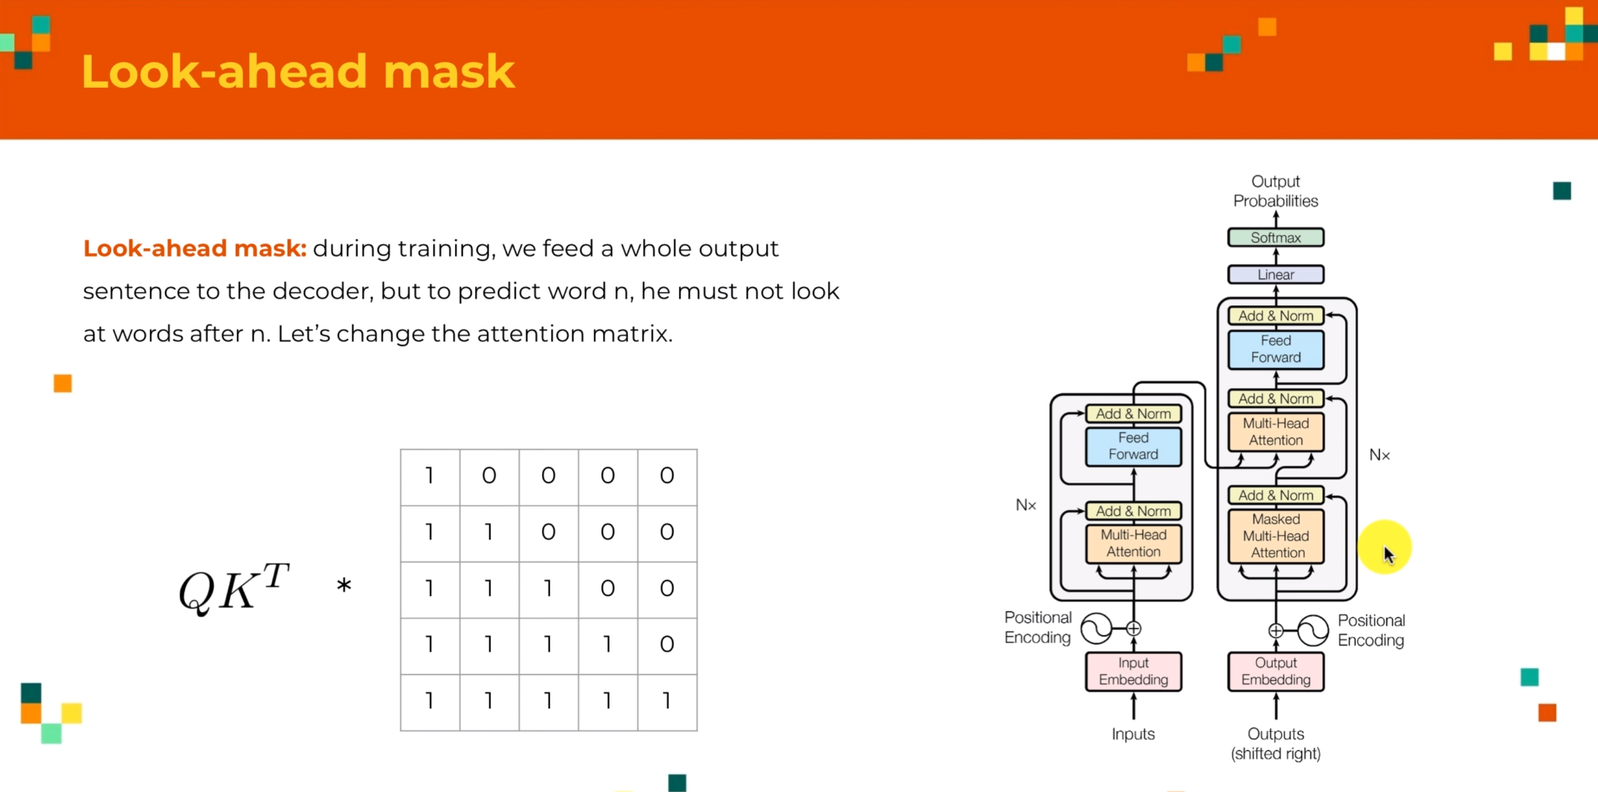
Look-ahead mask

Slide 23
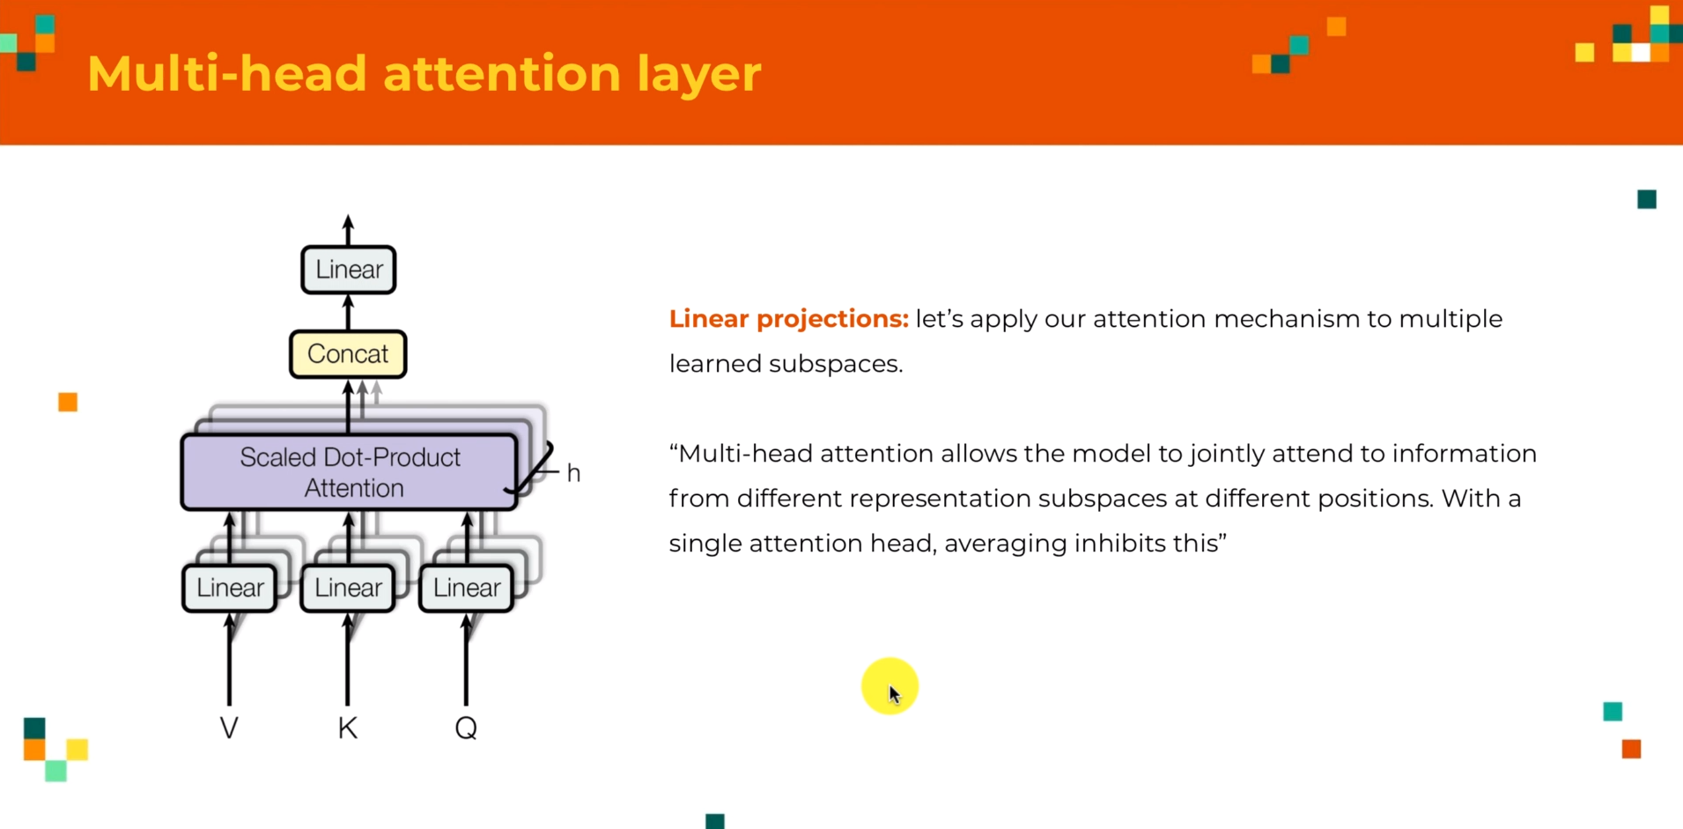
Multi-head attention layer
We don’t just apply the “Scaled-dot product” directly on the sentences;
What they do is that , they “first compute the linear projection” and then they do the “concatenation”
So instead of applying the “Scaled-dot product” attention to the whole sentence, they split each vector from the sentence into “sub spaces”;
Example : Say if each word in embedding has a dimension of 12 for instance, instead of applying the scaled-dot product to sequences made of dimension 12, we will split it into “4” sequences, each element being of dimension “3” and then we compute the “scaled dot-product attention” with that and we concatenate that results to get back to our initial dimension for our model;
(The reason for this as explained in the paper is that, they say Multi-head attention allows the transformer to attend from different representation sub-spaces into different positions;
With the single attention head, averaging inhibits this)

Slide 24
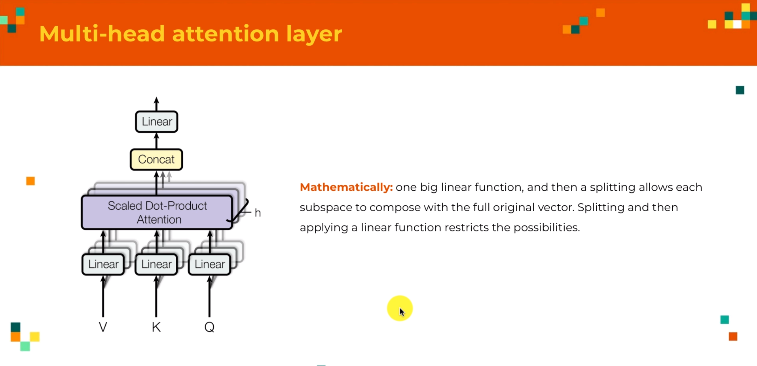
Multi-head attention layer

Slide 25
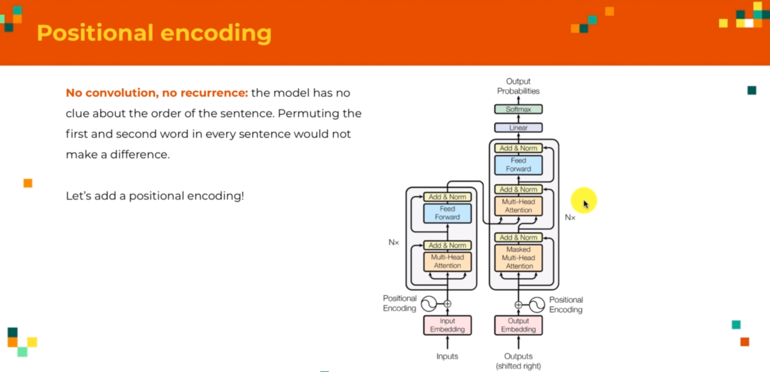
Positional Encoding
As per the architecture, after the input embedding, we apply (ADD”+”) a Positional Encoding;
Reason we do that:
In CNN or RNN, the order of the word have an impact on the process;
Now, with the Multi-head attention, we do the recomposing step and maybe example 3rd element of French sentence might attend to the 1st element of the English sentence, without regards to which position it is present. (This is not good thing, as we lose the positional space here);
So we need to have a way for our transformer to have an idea of the positions of the words in our sentences.
So let us add the positional embedding , the numbers after the embedding layers, that keep track of “positions of the words”

Slide 26
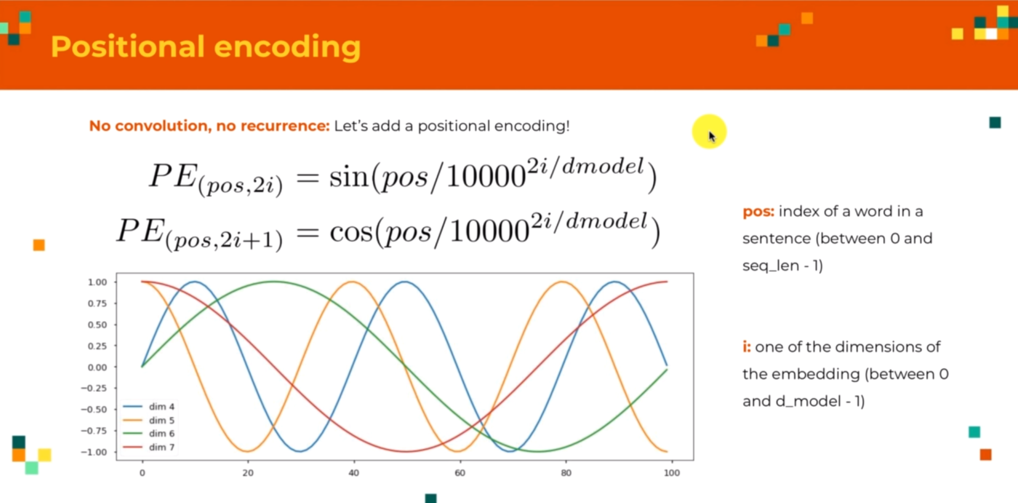
Positional Encoding

Slide 27
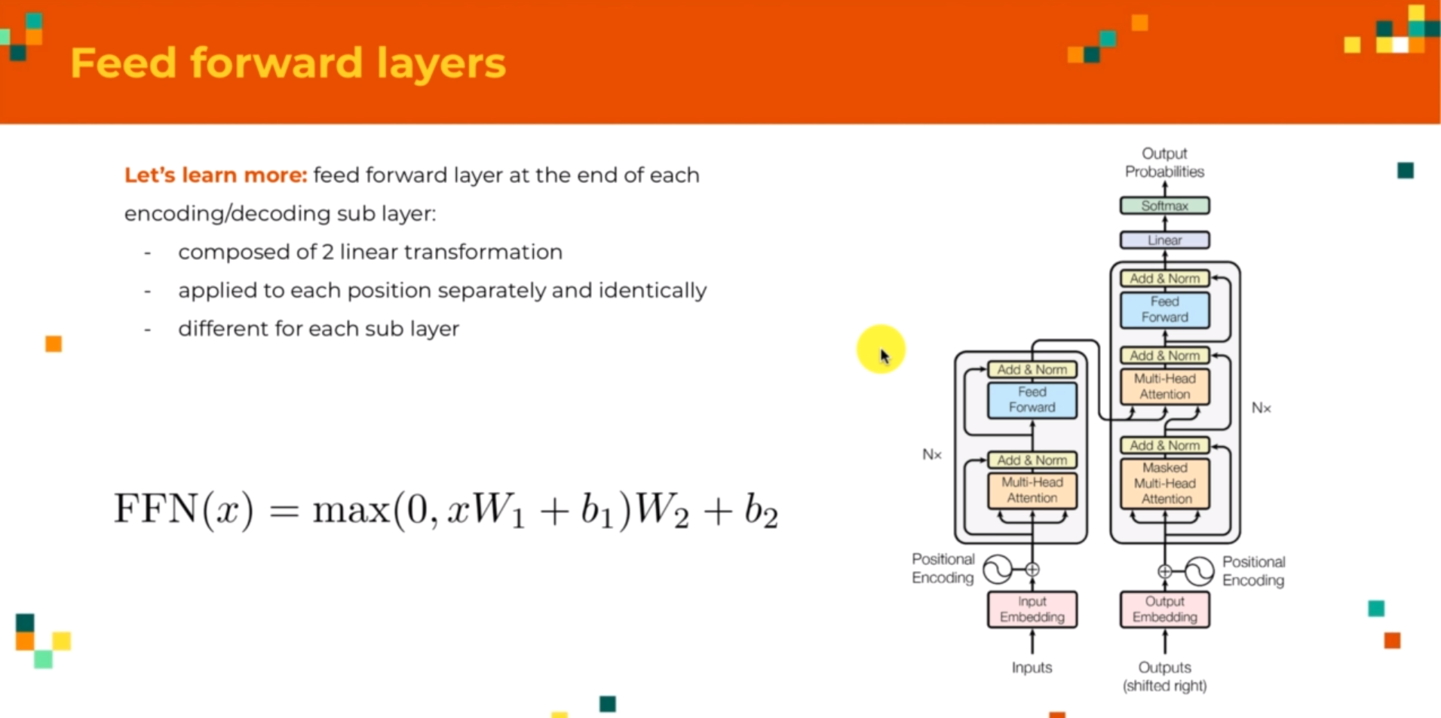
Transformer Architecture – Feed Forward Layers
This is just a 2 standard dense layers that we use in order to allow model to learn things by itself;
Each of these is made up of 2 linear transformations followed by a RELU Activation
For a single sequence, we will apply those 2 linear transformations to each of the elements into the dense layer;
This feedforward is different for each sublayer; For each of the encoding layers , we apply a different feedforward;
Example, 8 times 2 = 16 different feedforward sub-layers that our model has to learn;
This means there will be 32 layers, since based on the formula we have 2 dense layers;

Slide 28
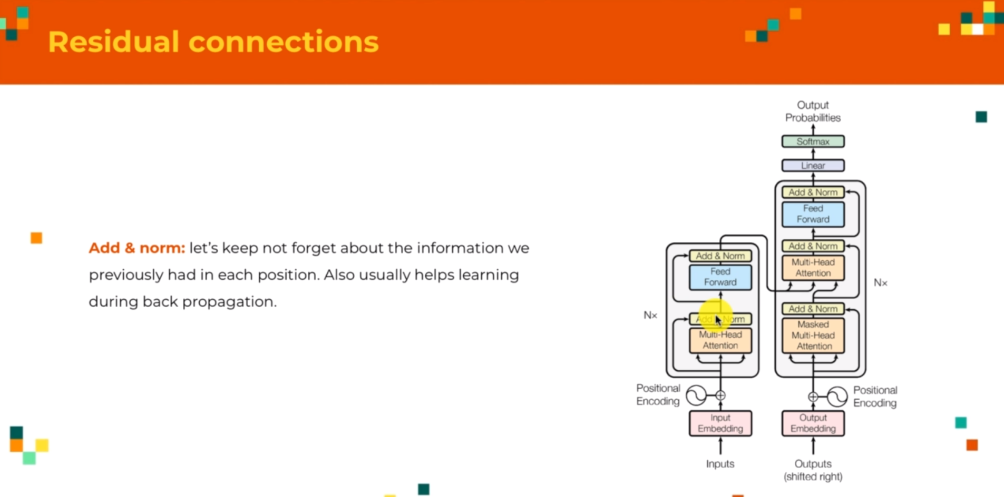
Transformer Architecture – Residual Connections
The “Add & norm” means that the outputs of those sub layers are also added to the input of the sub layers and then we do the standard “normalization”
There are 2 reasons why we do that:
We have of course computed new things gives us new information about our data, but we don’t want to forget the way it was before; (Example: for this self-attention mechanism, after recomposing the sentence we disregards the relationship between each words, but we want to still remember at least a bit, how the sentence was before, so it could be really useful to add the sentence back to the output of the self-attention sub-layer)
This is common in DL, as it is the residual connections and it makes the learning easier, particularly the back propagation, as a reminder how it is used to train the NN is that, we have to look at how our out put is close to the target and get the difference, so we know in which direction, we can change the weights, but instead of waiting till the end, knowing it at the start, will help getting the gradients in right direction (This residual network (Resnet) makes this backpropagation easier)

Slide 29
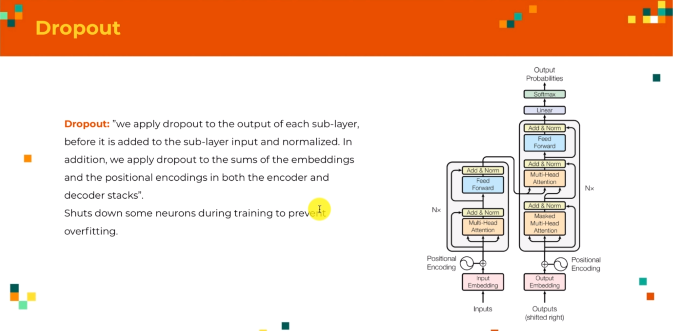
Transformer Architecture - Dropout

Slide 30
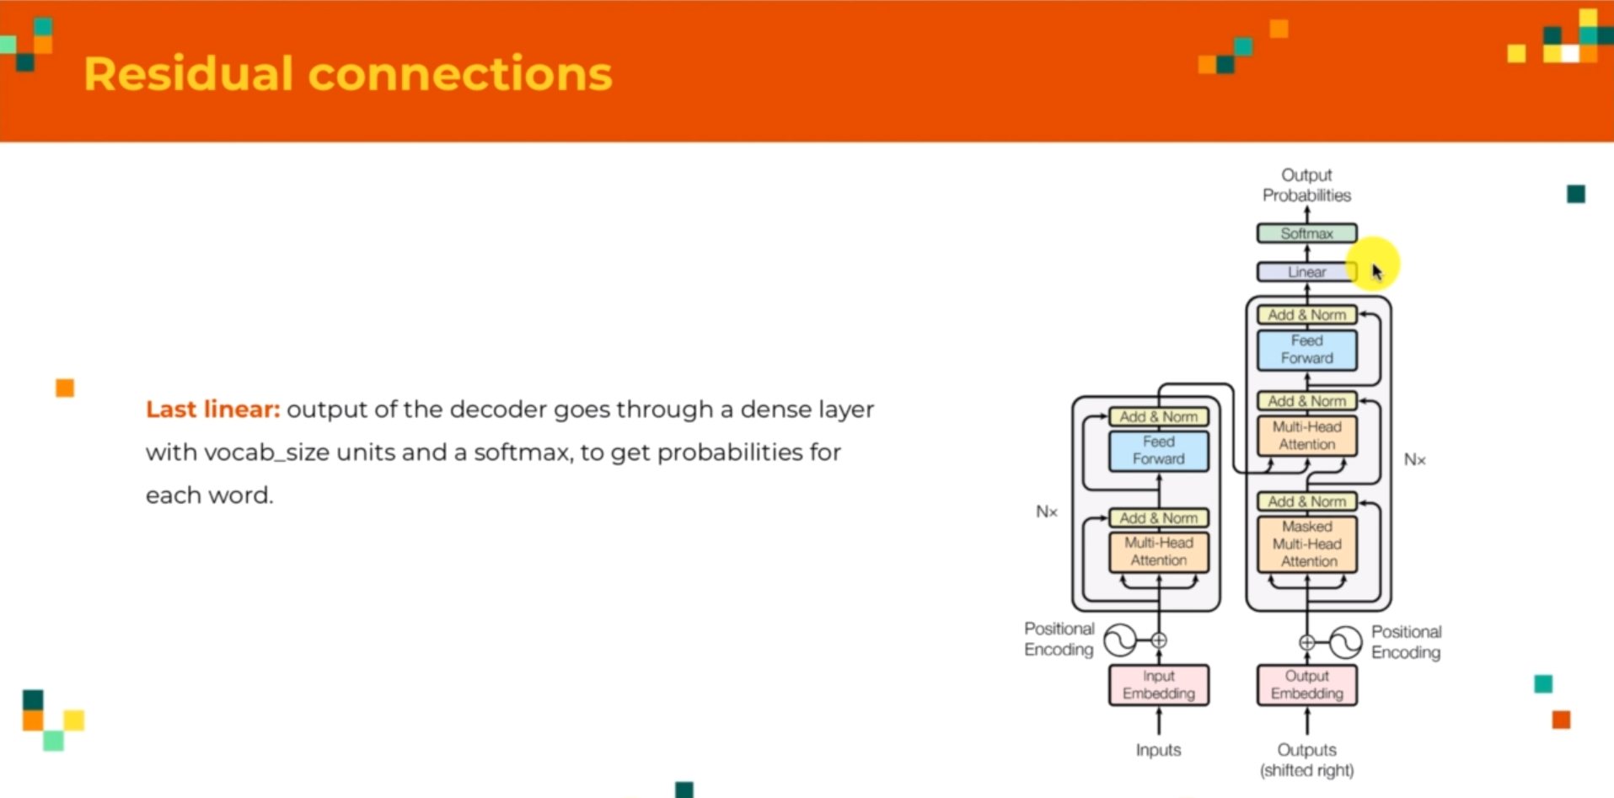
Transformer Architecture – Last Linear

